Slide 1


Crime Situation
January – December 2018
vs
January – December 2019
[UCPER Bravo Based] CIRAS Generated as of: January 1, 2010

Slide 2









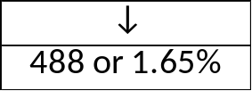









Total Crime Incidents

Slide 3








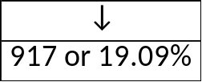
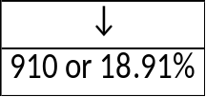






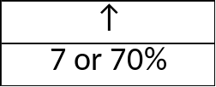
Index Crimes

Slide 4












Index Crimes
(Breakdown)
Murder
Homicide
Physical Injury
Rape
Robbery
Theft
Carnapping (MV)
Carnapping (MC)
Rape with Homicide
Kidnapping with
Homicide
Kidnapping with
Rape
Robbery with
Homicide
Robbery with
Serious Physical
Injury
Robbery with Rape
Robbery with Arson
Arson with
Homicide

Slide 5

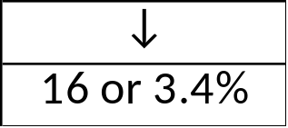







Murder
Back

Slide 6

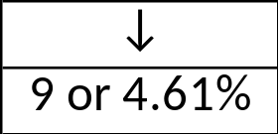







Homicide
Back

Slide 7




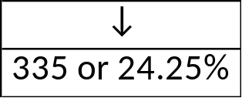




Physical Injury
Back

Slide 8


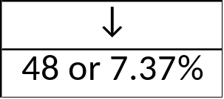






Rape
Back

Slide 9






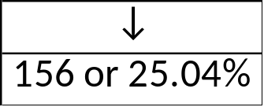


Robbery
Back

Slide 10






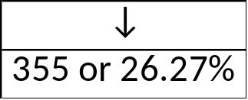


Theft
Back

Slide 11



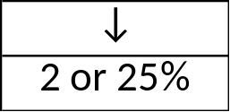



Carnapping (MV)
Back

Slide 12


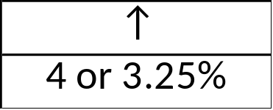






Carnapping (MC)
Back

Slide 13
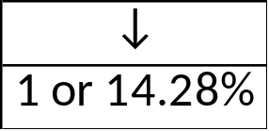



Rape with Homicide
Back

Slide 14
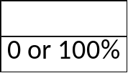


Kidnapping with Rape
Back

Slide 15
Kidnapping with Homicide
Back

Slide 16

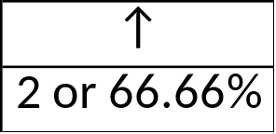
Robbery with Homicide
Back

Slide 17

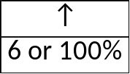


Robbery with Serious Physical Injury
Back

Slide 18
Robbery with Rape
Back

Slide 19
Robbery with Arson
Back

Slide 20
Arson with Homicide
Back

Slide 21

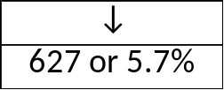







Non – Index Crimes

Slide 22








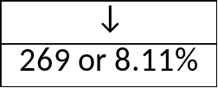







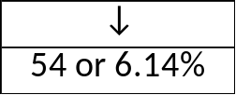

Non – Index Crimes
(Breakdown)

Slide 23








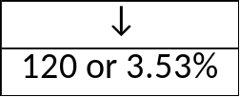








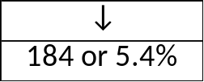
Non – Index Crimes
(Breakdown)

Slide 24
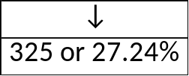
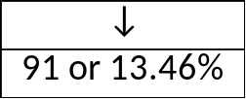
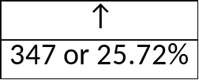
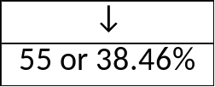
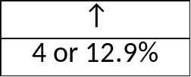
Police Operations
(breakdown)
Illegal Drugs
Illegal Gambling
Illegal Possession of Firearms
Illegal Logging
Illegal Fishing

Slide 25

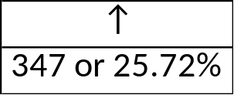







Illegal Drugs

Slide 26



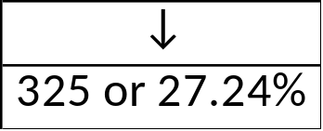





Illegal Gambling

Slide 27




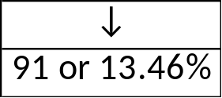




Illegal Possession of Firearms
Back

Slide 28


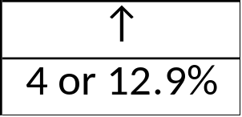



Illegal Logging
Back

Slide 29




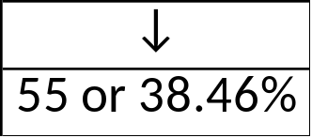



Illegal Fishing
Back

Slide 30








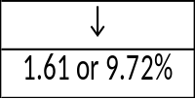








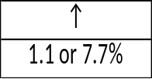
Average Monthly Crime Rate

Slide 31
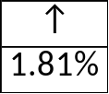















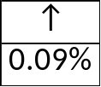

Crime Clearance Efficiency

Slide 32






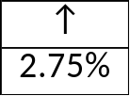










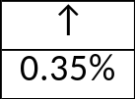
Crime Solution Efficiency

Slide 33
End of Presentation

Slide 34








Total Crime Incidents (POI + PSI)

Slide 35







Index Crimes

